Slide 1
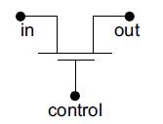
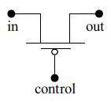
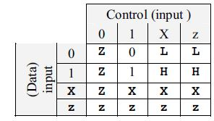
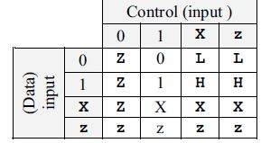
BASIC SWITCH PRIMITIVES
Figure 1 An NMOS switch with terminals.
Figure 2 A PMOS switch with terminals
In the table the symbol “L” stands for 0 or z state. The
symbol H stands for the 1 or z state.
Table 1 Output values of an
nmos switch for different
values of signal and control
inputs
Table 2 Output values of a
pmos switch for different
values of signal and control
inputs

Slide 2
RESISTIVE SWITCHES
nmos and pmos represent switches of low impedance in the on-state.
rnmos and rpmos represent the resistive counterparts of these respectively.
Typical instantiations have the form
rnmos (output1, input1, control1);
rpmos (output2, input2, control2);
With rnmos if the control1 input is at 1 (high) state, the switch is ON and functions as a definite resistance. It connects input1 to output1 through a resistance. When control1 is at the 0 (low) state, the switch is OFF and leaves output1 floating. The set of output values for all combinations of input1 and control1 values remain identical to those of the nmos switch given in Table 1.
The rpmos switch is ON when control2 is at 0 (low) state. It inserts a definite resistance between the input and the output signals but retains the signal value. The output values for different input values remain identical to those in Table 2 for the pmos switch.

Slide 3
pullup and pulldown
A MOS transistor functions as a resistive element when in the active state
Realization of resistance in this form takes less silicon area in the IC as compared to a resistance realized directly
pullup and pulldown represent such resistive elements
A typical instantiation here has the form pullup (x);
Here the net x is pulled up to the supply1 through a resistance
Similarly, the instantiation pulldown(y);
pulls y down to the supply0 level through a resistance
The pullup and pulldown primitives can be used as loads for switches or to connect the unused input ports to VCC or GND, respectively
They can also form loads of switches in logic circuits
The default strengths for pullup and pulldown are pull1 and pull0 respectively. One can also specify strength values for the respective nets

Slide 4
pullup and pulldown --Cont’d
For example
pullup (strong1) (x)
specifies a resistive pullup of net x to supply1
One can also assign names to the pullup and pulldown primitives
Thus pullup (strong1) rs(x) represents an instantiation of pullup designated rs having strength strong1
Difference between tri and pullup or pulldown is to be understood clearly
pullup is a functional element; it represents a resistive connection to supply1
In contrast tri1 is a type of net; in the absence of an assignment, it remains connected to supply1
A similar difference exists between pulldown and tri0

